Slide 1
Mini Project 3: Chemical Manufacturing Analysis
Team Pineapple
Samia, Sal, Nik

Slide 2
Introduction
Analyze a chemical manufacturing process for Smith-Brown Industrial Chemicals Inc. refinery on the Monongahela River in Pittsburgh PA.
Determine the most cost-effective method for handling liquid waste from a manufacturing process.

Slide 3

Methodology
Tools and skills for completing this project:
Software used includes Excel solver (using the Simplex Method)
Operations research techniques for optimization

Slide 4
Scenario Breakdown
The company’s primary product is manufactured from a chemical process that requires the use of 2 raw materials:
Material X
Material Y
The production of one pound of the primary product requires:
1 lb of material X
2 lb of material Y
The output of the chemical process is:
1 lb of the primary product
1 lb of liquid waste material
1 lb of solid waste by-product

Slide 5
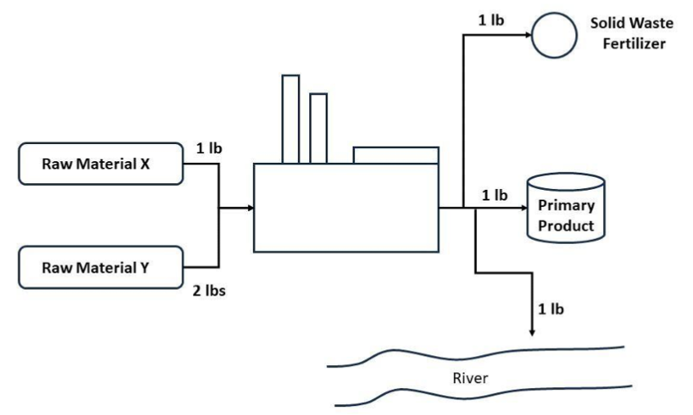
Scenario Breakdown

Slide 6
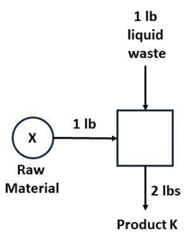
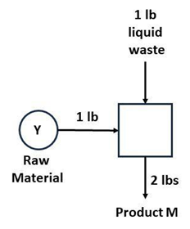
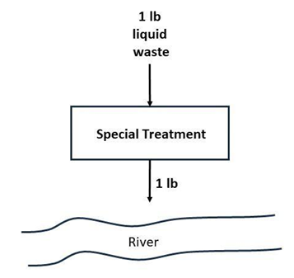
Scenario Breakdown
New guidelines prohibit disposal of liquid waste directly into the river
Alternatives for the liquid waste proposed by refinery's research group:
Produce a secondary product K by adding 1 lb of raw material X to every lb of liquid waste.
Produce a secondary product M by adding 1 lb of raw material Y to every lb of liquid waste.
Specially treat the liquid waste so that it meets pollution standard before dumping it into the river.

Slide 7
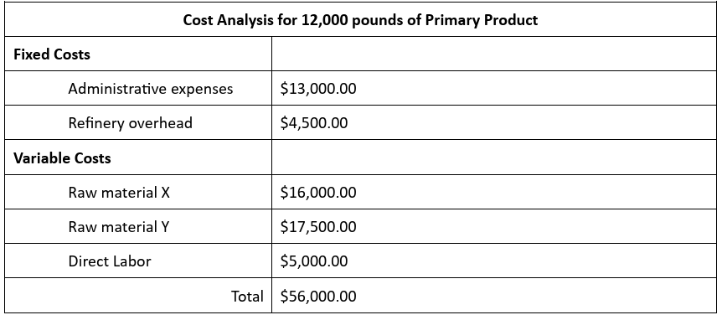
Scenario Breakdown
Determine optimal allocation of production quantities to satisfy pollution regulations while maximizing profit:
What is the ideal combination of product output?

Slide 8
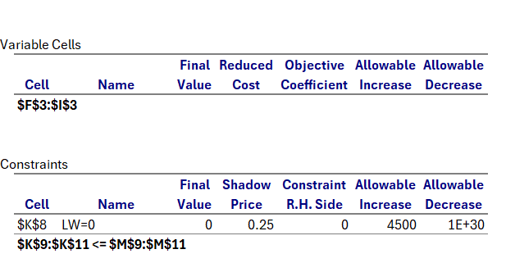
Methodology
RMY can be increased by 6000 before RMX needs to be increased at all.

Slide 9
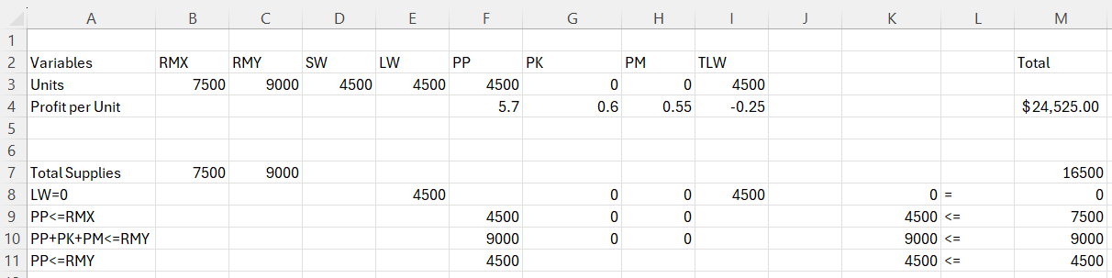
Excel Model
Decision Variables: PP, PK, PM, TLW
Constraints:
Objective Function: PP(5.7)+PK(0.6)+PM(0.55)+TLW(4500)

Slide 10
Excel Model - Constraints

Slide 11
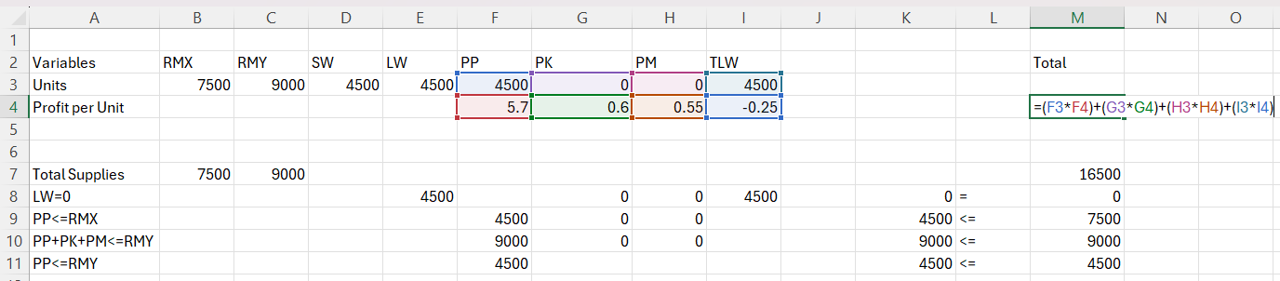
Excel Model – Objective Function
Simply put, it is the number of pounds of PP, PK, PM, and TLW multiplied by their respective profit or cost, and then the sum of those quantities.

Slide 12
Analysis
The accountant's recommendation is reasonable given that any amount of raw material Y is better used producing more primary product then treating the liquid waste until all of material X is used.
The optimal solution does not change if product K were eliminated.

Slide 13
Conclusions
Fixed costs were $17500 and income $24525,
$24525 - $17500 = $7025 total profits.
Biggest Challenge: Troubleshooting the Solver tool
Possible improvement:
There is likely a better way to set up the information so that less cells need to be changed.

Slide 14
Thank You!

